Slide 1

SCMS SCHOOL OF ENGINEERING AND TECHNOLOGY DEPARTMENT OF COMPUTER SCIENCE AND ENGINEERING
OPEN-SOURCE INTELLIGENCE FRAMEWORK FOR CROSS-PLATFORM SOCIAL MEDIA ANALYTICS
AI Driven IoT Framework for Energy
Optimization in Ductless HVAC Systems
Project Guide :
Dr. Noora V T
Associate Professor
Dept. of Computer Science and Engineering
SSET
Presented by :
Mr. Athul Krishna S [SCM22CS072]
Mr. James Renil Sebastian [SCM22CS122]
Mr. Johan Itty Jones[SCM22CS130]
Mr. Luke Rommel Mylaady[SCM22CS138]
1

Slide 2
CONTENTS
AI Driven IoT Framework for Energy Optimization in Ductless HVAC Systems
INTRODUCTION
OBJECTIVE OF THE PROJECT
SYSTEM ARCHITECTURE
IMPLEMENTATION DETAILS
ROAD MAP OF THE PROJECT
PROGRESS
REFERENCES
SCREENSHOTS

Slide 3
INTRODUCTION
AI Driven IoT Framework for Energy Optimization in Ductless HVAC Systems
Rising demand for energy-efficient cooling solutions in homes and offices.
Traditional ductless Heating Ventilation and Air Conditioning systems (HVAC) lack intelligent
control, leading to energy waste.
Our project introduces an IoT-based smart system to monitor HVAC parameters in real time.
Uses Nearest Neighbor-Density Based Spatial Clustering of Applications with Noise(NN
-DBSCAN) algorithm to detect anomalies and optimize energy usage.
Designed as a lightweight, scalable, and user-friendly solution with a real-time dashboard.
Reduces dependency on complex cloud-based infrastructure or costly AI setups.

Slide 4
OBJECTIVE OF THE PROJECT
AI Driven IoT Framework for Energy Optimization in Ductless HVAC Systems
Monitor real-time environmental and HVAC system parameters (temperature, voltage,
current).
Detect anomalies in power usage using NN-DBSCAN clustering algorithm.
Optimize energy consumption dynamically based on usage patterns and detected anomalies.
Develop a modular IoT setup suitable for ductless HVAC systems in small offices and
homes.
Provide a real-time dashboard for user interaction, system monitoring, and control
decisions.

Slide 5

MOTIVATION OF THE PROJECT
AI Driven IoT Framework for Energy Optimization in Ductless HVAC Systems
HVAC systems account for a major portion of global energy consumption.
Inefficient operation and lack of monitoring cause significant energy wastage.
Existing smart HVAC solutions are either too expensive or dependent on complex cloud infrastructure.
Recent advancements in IoT, edge computing, and AI algorithms enable lightweight and affordable smart control systems.
Motivation: build a system that reduces energy waste while being simple enough for small-scale environments.

Slide 6
CHALLENGES AND CONSIDERATIONS
AI Driven IoT Framework for Energy Optimization in Ductless HVAC Systems
Accurate real-time data acquisition from multiple sensors (temperature, current, voltage).
Ensuring seamless data transmission and synchronization in the IoT network.
Maintaining system stability under fluctuating loads and environmental conditions.
Minimizing computational overhead for edge processing on devices like Raspberry Pi.
Designing an adaptive algorithm that performs well across different HVAC models.
Balancing energy optimization with user comfort.

Slide 7
LITERATURE SURVEY
AI Driven IoT Framework for Energy Optimization in Ductless HVAC Systems
Sl. No | Title | Author(s) | Methodology | Inference
1. | Artificial Intelligence Approaches to Energy Management in HVAC Systems | S.A. Aghili et al., 2025 | Reviewed AI-based optimization and fault detection techniques for HVAC energy management. | Demonstrated potential of AI models in reducing energy consumption by 15–25%.
2. | Bayesian Optimization Framework for HVAC Control | X. Lin et al., 2023 | Developed a Bayesian framework for automatic adjustment of control parameters. | Improved adaptability to dynamic temperature and occupancy patterns
3. | Deep Learning Forecasting for Cooling Systems | J. Runge & R. Zmeureanu, 2022 | Applied deep learning to forecast cooling demand and optimize scheduling. | Enhanced prediction accuracy and reduced overall energy use.

Slide 8
LITERATURE SURVEY
AI Driven IoT Framework for Energy Optimization in Ductless HVAC Systems
Sl. No | Title | Author(s) | Methodology | Inference
4. | Computing-Based Automated Fault Detection in HVAC Systems | J. Chen et al., 2022 | Designed ML-based fault detection systems for HVAC diagnosis. | Reduced downtime and improved system reliability.
5. | Intelligent Fault Detection and Energy Optimization in HVAC Systems using IoT and Machine Learning | M. Rahbar, A. H. Rezaei, and M. Khanzadi, 2024 | Proposed an IoT-based HVAC monitoring system integrated with a machine learning model for fault detection and predictive energy control. | Demonstrated improved energy efficiency and faster fault diagnosis compared to traditional systems.

Slide 9
METHODOLOGY
AI Driven IoT Framework for Energy Optimization in Ductless HVAC Systems
1. Data Acquisition
Sensors measure real-time temperature, voltage, and current from the HVAC system.
Data transmitted to Raspberry Pi for local processing.
2. Pre-Processing
Raw data filtered and normalized to eliminate sensor noise.
3. Anomaly Detection (NN-DBSCAN)
Algorithm clusters normal and abnormal patterns in power usage.
Detects deviations caused by faults or inefficiencies.

Slide 10
METHODOLOGY
AI Driven IoT Framework for Energy Optimization in Ductless HVAC Systems
4. Optimization Logic
  Uses detected anomalies to adjust system operation dynamically.
  Ensures minimal energy wastage and stable performance.
5. Visualization & Feedback
  Real-time results displayed on Blynk dashboard.
  System continuously updates based on latest readings.
11

Slide 11
MODULE DESCRIPTION
AI Driven IoT Framework for Energy Optimization in Ductless HVAC Systems
Module 1 – Sensor Integration & Data Collection
Connects voltage, current, and temperature sensors to Raspberry Pi.
Collects and logs real-time data for analysis.
Module 2 – Data Preprocessing & Filtering
Filters noisy data and prepares it for anomaly detection.
Stores clean datasets for training and testing.
Module 3 – Anomaly Detection using NN-DBSCAN
Clusters energy data and flags unusual usage patterns.
Provides alerts via the dashboard.
23-10-2025
Department of Computer Science and Engineering, SSET
12

Slide 12
MODULE DESCRIPTION
AI Driven IoT Framework for Energy Optimization in Ductless HVAC Systems
Module 4 – Optimization and Control Logic
Executes adaptive control strategies to minimize energy waste.
Maintains desired comfort levels automatically.
Module 5 – Dashboard & User Interface
Displays system data (temperature, voltage, current) in real time.
Allows user monitoring and manual overrides through the Blynk app.
23-10-2025
Department of Computer Science and Engineering, SSET
12

Slide 13
IMPLEMENTATION DETAILS
AI Driven IoT Framework for Energy Optimization in Ductless HVAC Systems
Implementation done on Raspberry Pi 5 using Python as the primary language.
Libraries used: NumPy, Pandas, Scikit-learn, Matplotlib, Blynk Library, and RPi.GPIO.
Sensors connected via ADS1115 analog-to-digital converter.
Communication established using Wi-Fi (MQTT protocol).
NN-DBSCAN model implemented and trained on collected data samples.
Real-time data visualization achieved using Blynk Dashboard.
Output results stored and analyzed in Excel for pattern verification and model tuning.
Department of Computer Science and Engineering, SSET
14

Slide 14
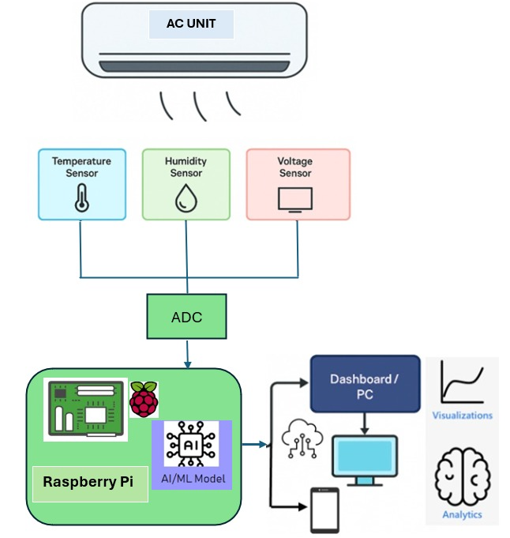
SYSTEM ARCHITECTURE
AI Driven IoT Framework for Energy Optimization in Ductless HVAC Systems
SBC used:
Raspberry pi-5
Clustering Algorithm:
NN-DBSCAN
Coding Language:
Python
Dashboard used:
BLYNK
Current Sensor:
SCT-013-030
Voltage Sensor:
ZMPT101B
Temperature Sensor:
Waveshare O44 T22
ADC used:
ADS 1115

Slide 15
PROGRESS
AI Driven IoT Framework for Energy Optimization in Ductless HVAC Systems
Integrated temperature, voltage, and current sensors with Raspberry Pi.
Data pipeline configured for real-time collection.
System ready for testing and model training phase.
Output to be logged and analyzed in Excel for initial results.

Slide 16
.
AI Driven IoT Framework for Energy Optimization in Ductless HVAC Systems
ROADMAP OF THE PROJECT
No. | TASK NAME | 01-08-2025 | 05-08-2025 | 12-08-2025 | 01-09-2025 | 15-09-2025 | 15-10-2025 | 30-11-2025 | 01-12-2025 | 15-01-2026 | 31-01-2026 | 28-02-2026 | 01-03-2026 | 17-03-2026
1 | Project Proposal For submission
2 | Literature Review
3 | Objective Finalization
4 | System Architecture Design
5 | Hardware Integration & Initial Testing
6 | Sensor Calibration & Data Validation
7 | Data Collection
8 | Model Training & NN-DBSCAN Implementation
9 | Result Analysis & Optimization
10 | Evaluation & Dashboard Integration
11 | Final Presentation, Project Demo & Project Report submission

Slide 17
.
AI Driven IoT Framework for Energy Optimization in Ductless HVAC Systems
ROADMAP OF THE PROJECT
No. | TASK NAME | 01-08-2025 | 05-08-2025 | 12-08-2025 | 01-09-2025 | 15-09-2025 | 15-10-2025 | 30-11-2025 | 01-12-2025 | 15-01-2026 | 31-01-2026 | 28-02-2026 | 01-03-2026 | 17-03-2026
1 | Project Proposal For submission
2 | Literature Review
3 | Objective Finalization
4 | System Architecture Design
5 | Hardware Integration & Initial Testing
6 | Sensor Calibration & Data Validation
7 | Data Collection
8 | Model Training & NN-DBSCAN Implementation
9 | Result Analysis & Optimization
10 | Evaluation & Dashboard Integration
11 | Final Presentation, Project Demo & Project Report submission

Slide 18
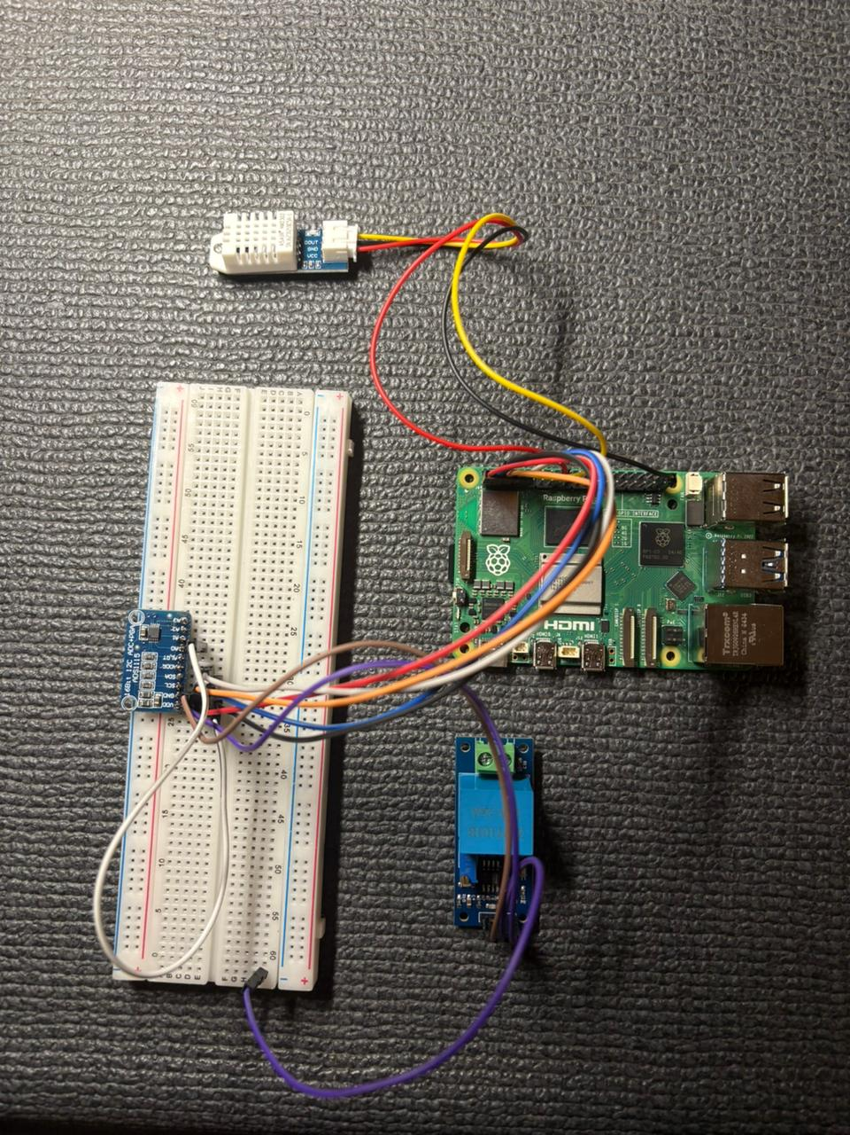
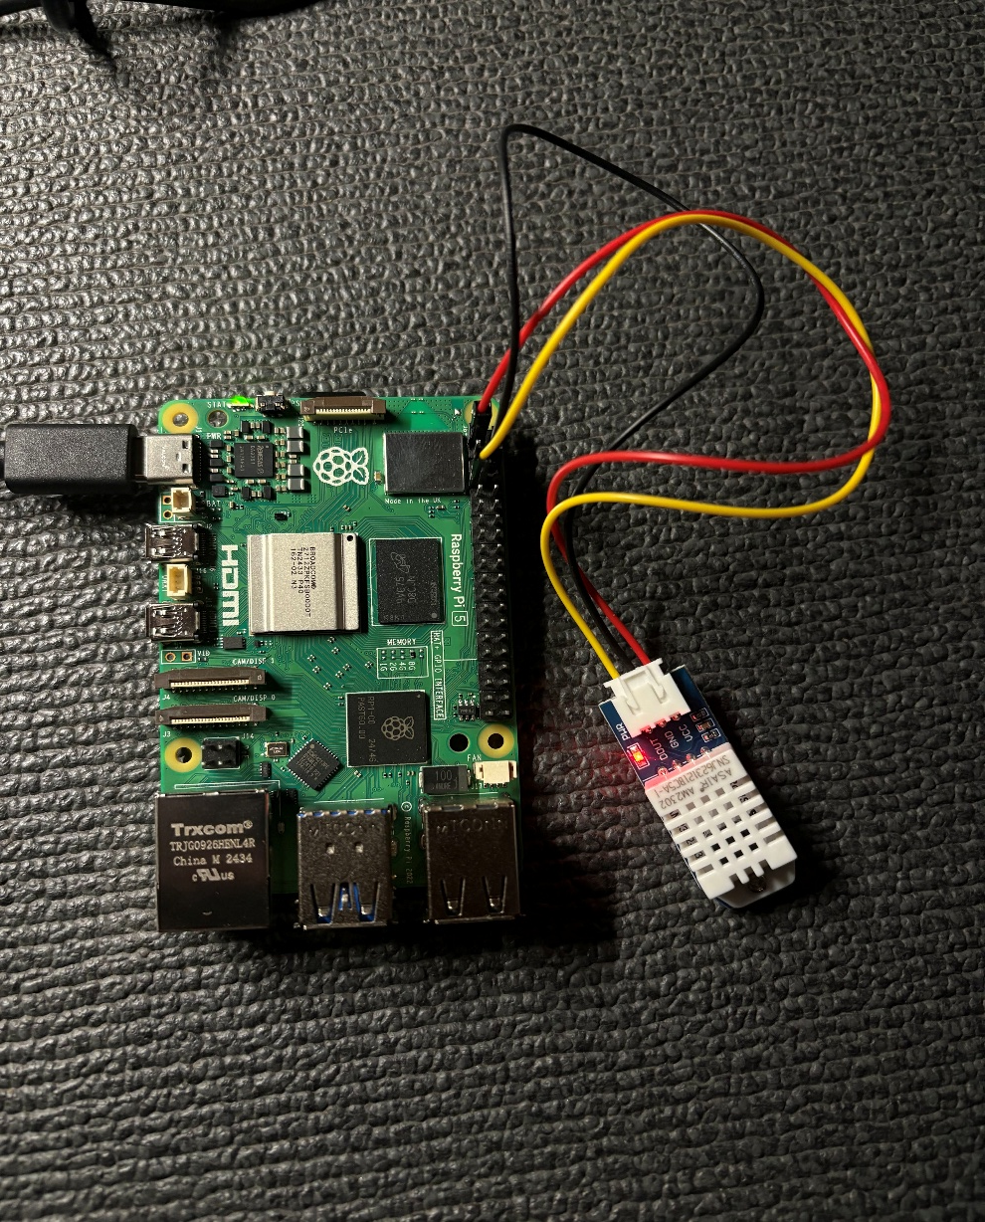
SCREENSHOTS
AI Driven IoT Framework for Energy Optimization in Ductless HVAC Systems

Slide 19
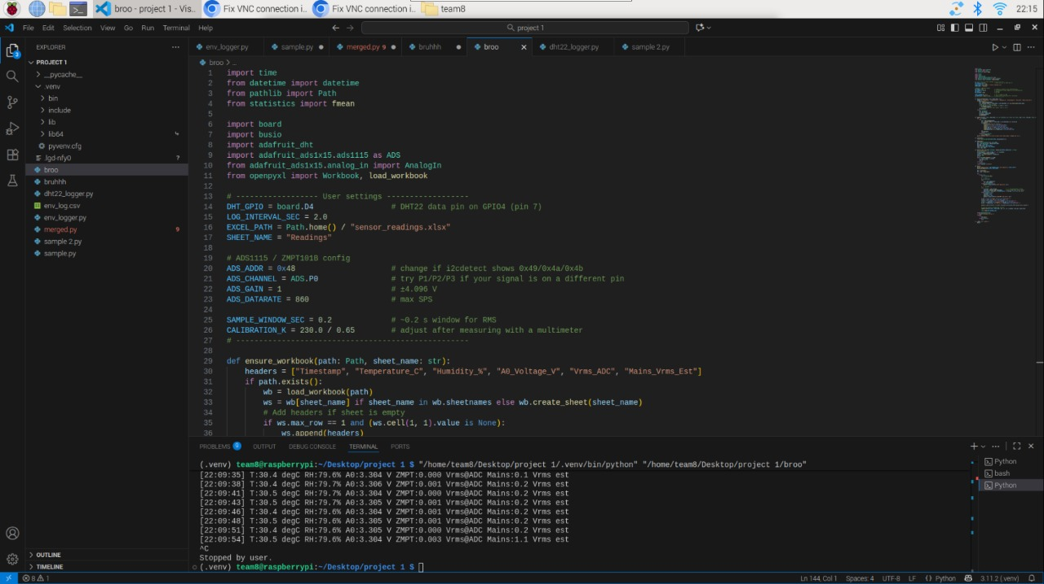
SCREENSHOTS
AI Driven IoT Framework for Energy Optimization in Ductless HVAC Systems

Slide 20
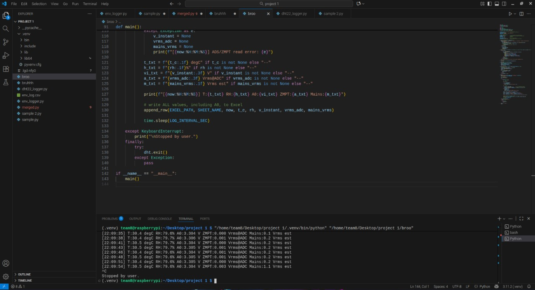
SCREENSHOTS
AI Driven IoT Framework for Energy Optimization in Ductless HVAC Systems

Slide 21
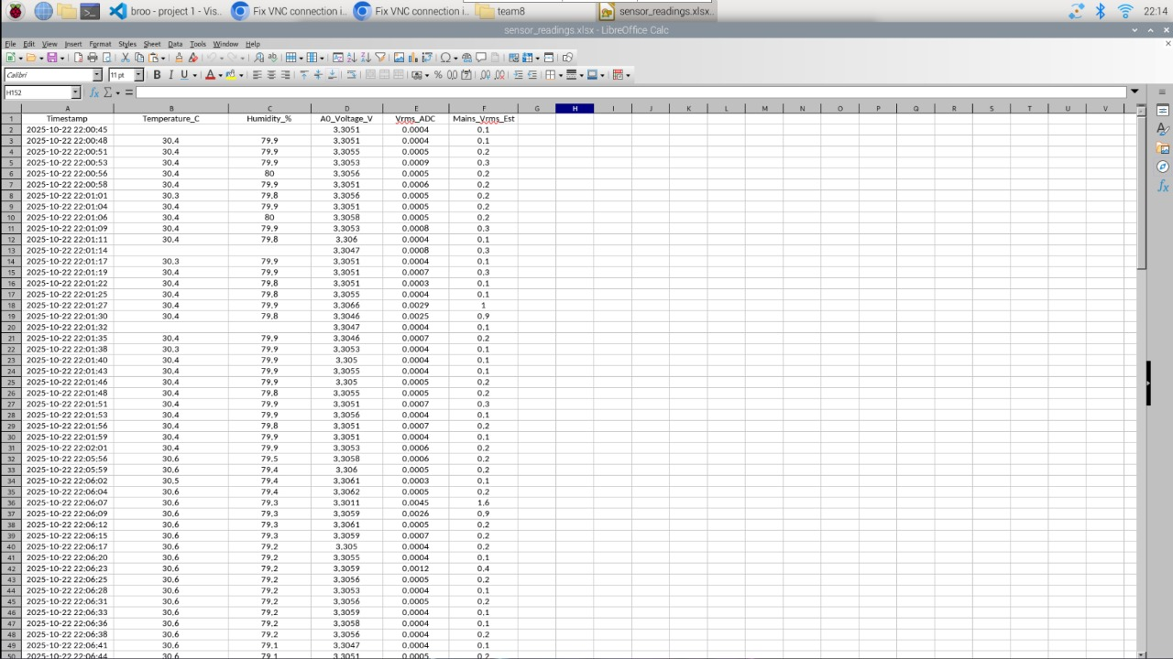
SCREENSHOTS
AI Driven IoT Framework for Energy Optimization in Ductless HVAC Systems

Slide 22
REFERENCES
AI Driven IoT Framework for Energy Optimization in Ductless HVAC Systems
[1] S. A. Aghili, A. H. M. Rezaei, M. Tafazzoli, M. Khanzadi, and M. Rahbar, “Artificial intelligence approaches to energy management in HVAC systems: A systematic review,” Buildings, vol. 15, p. 1008, 2025.
[2] X. Lin, Q. Guo, D. Yuan, and M. Gao, “Bayesian optimization framework for HVAC system control,” Buildings, vol. 13, p. 314, 2023.
[3] H.-P. Ni, W. O. Chong, and J.-S. Chou, “Optimizing HVAC systems for semiconductor fabrication: A data-intensive framework for energy efficiency and sustainability,” Journal of Building Engineering, 2024.
[4] J. Runge and R. Zmeureanu, “Deep learning forecasting for electric demand applications of cooling systems in buildings,” Advanced Engineering Informatics, 2022.
[5] J. Chen, L. Zhang, Y. Li, Y. Shi, X. Gao, and Y. Hu, “A review of computing-based automated fault detection and diagnosis of heating, ventilation and air conditioning systems,” Renewable and Sustainable Energy Reviews, vol. 161, 2022.

